Slide 1

MIND GUESSING
GAME PLUS
A C++ Object-Oriented Console Game
OOP
File Handling
Login System
Console UI
Group : Abdullah 039
Mustafa 053
Samar 075
C++ • Windows Console • PBO Demonstration

Slide 2
TABLE OF CONTENTS
What We'll Cover
01
Project Overview
02
System Architecture
Purpose, goals and tech stack
OOP design with base & derived class
03
Login System
04
Game Mechanics
Sign Up / Sign In with file storage
The math trick behind the guessing
05
File Handling
06
Key Features
Player data & session logging
UI, prizes, scoreboard & design patterns

Slide 3
01 / PROJECT OVERVIEW
What Is This Game?
Mind Guessing Game Plus is a C++ console application that uses a mathematical trick to 'read' a player's mind. The program walks the user through arithmetic steps, then reveals their original number — making it seem like magic.
2
Classes
Base + Derived
TECHNOLOGY USED
15+
C++
windows.h
fstream
Methods
ctime
conio.h
Organized & Modular
2
Files
players.txt, session_log

Slide 4
02 / SYSTEM ARCHITECTURE
OOP Class Design
BASE CLASS
DERIVED CLASS
Game
MindGame
# playerName : string
# gamesPlayed : int
+ setColor(int)
+ clearScreen()
+ slowPrint(string, int)
+ menuChoice(int, int)
+ pauseScreen()
+ loadingBar(string)
+ run() = 0 ← pure virtual
- password : string
+ title()
+ rules()
+ playRound() : int
+ showPrize(int)
+ showScore()
+ signUp() : bool
+ signIn() : bool
+ run() ← override
inherits

Slide 5


03 / LOGIN SYSTEM
Authentication & User Management
SIGN UP
SIGN IN
1. User enters a new username
2. User creates a password
3. Data written to players.txt
→ playerName
→ password
→ gamesPlayed = 0
4. Account created successfully
1. User inputs username & password
2. File opened: players.txt
3. Credentials compared line-by-line
4. If match → login successful
→ loads gamesPlayed count
5. If no match → error message
6. Returns bool (true/false)
vs

Slide 6
04 / GAME MECHANICS
The Math Behind the Magic
1
Pick Your Number
WHY IT WORKS
Player mentally picks N (1–9)
Let N = your number
Let R = game's even number
Step 2: N + N = 2N
Step 3: 2N + R
Step 4: (2N + R) / 2
= N + R/2
Step 5: N + R/2 − N
= R/2
Result = R / 2
(always independent of N!)
2
Add Friend's Number
Add another N (same value)
3
Add Game's Number
Program adds rand number R (2–20, even)
4
Divide by 2
Player divides total by 2
5
Subtract Friend's N
Player subtracts the friend's number

Slide 7
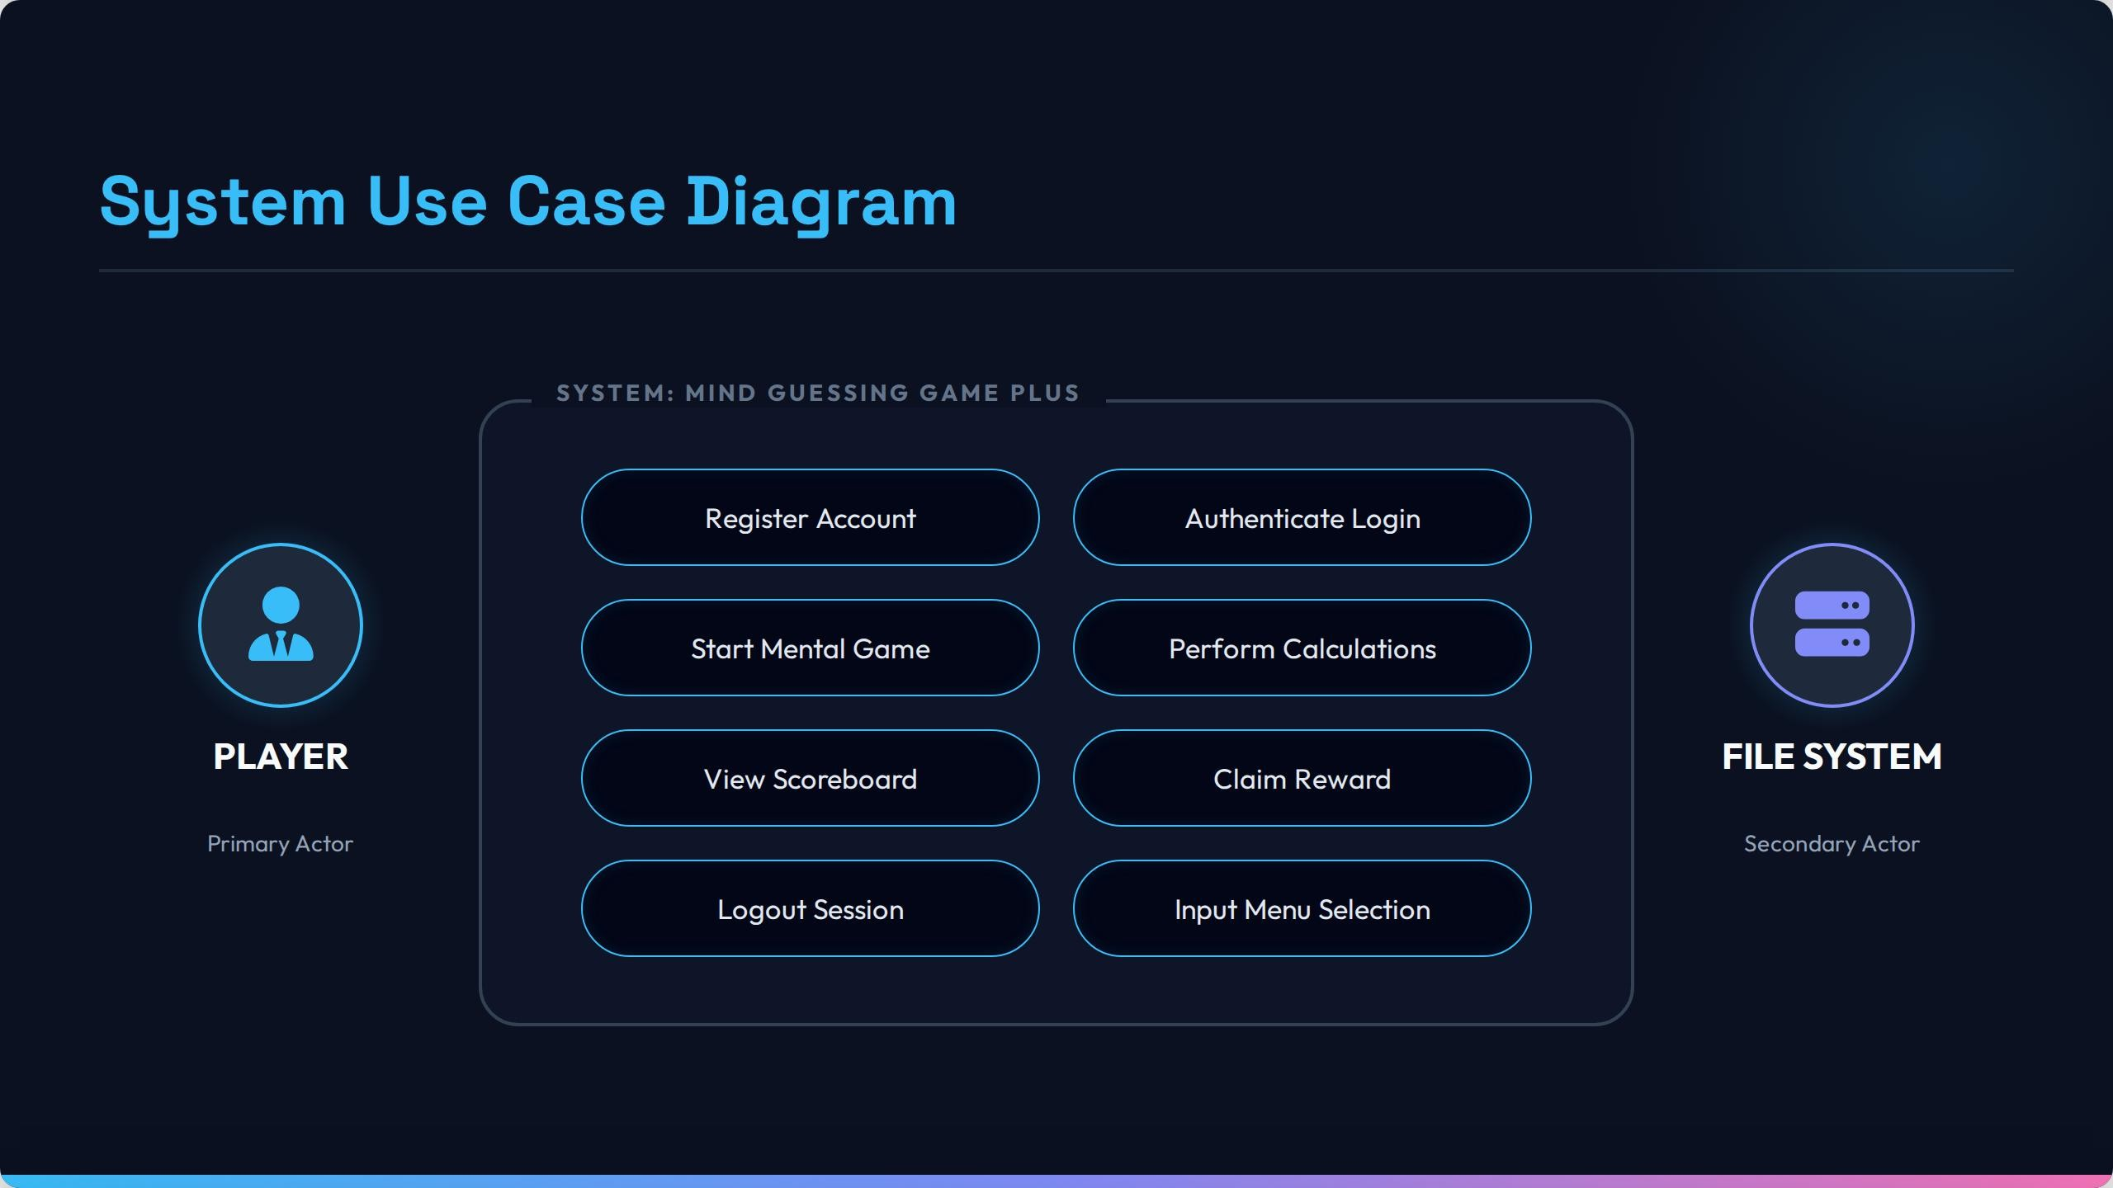

Slide 8
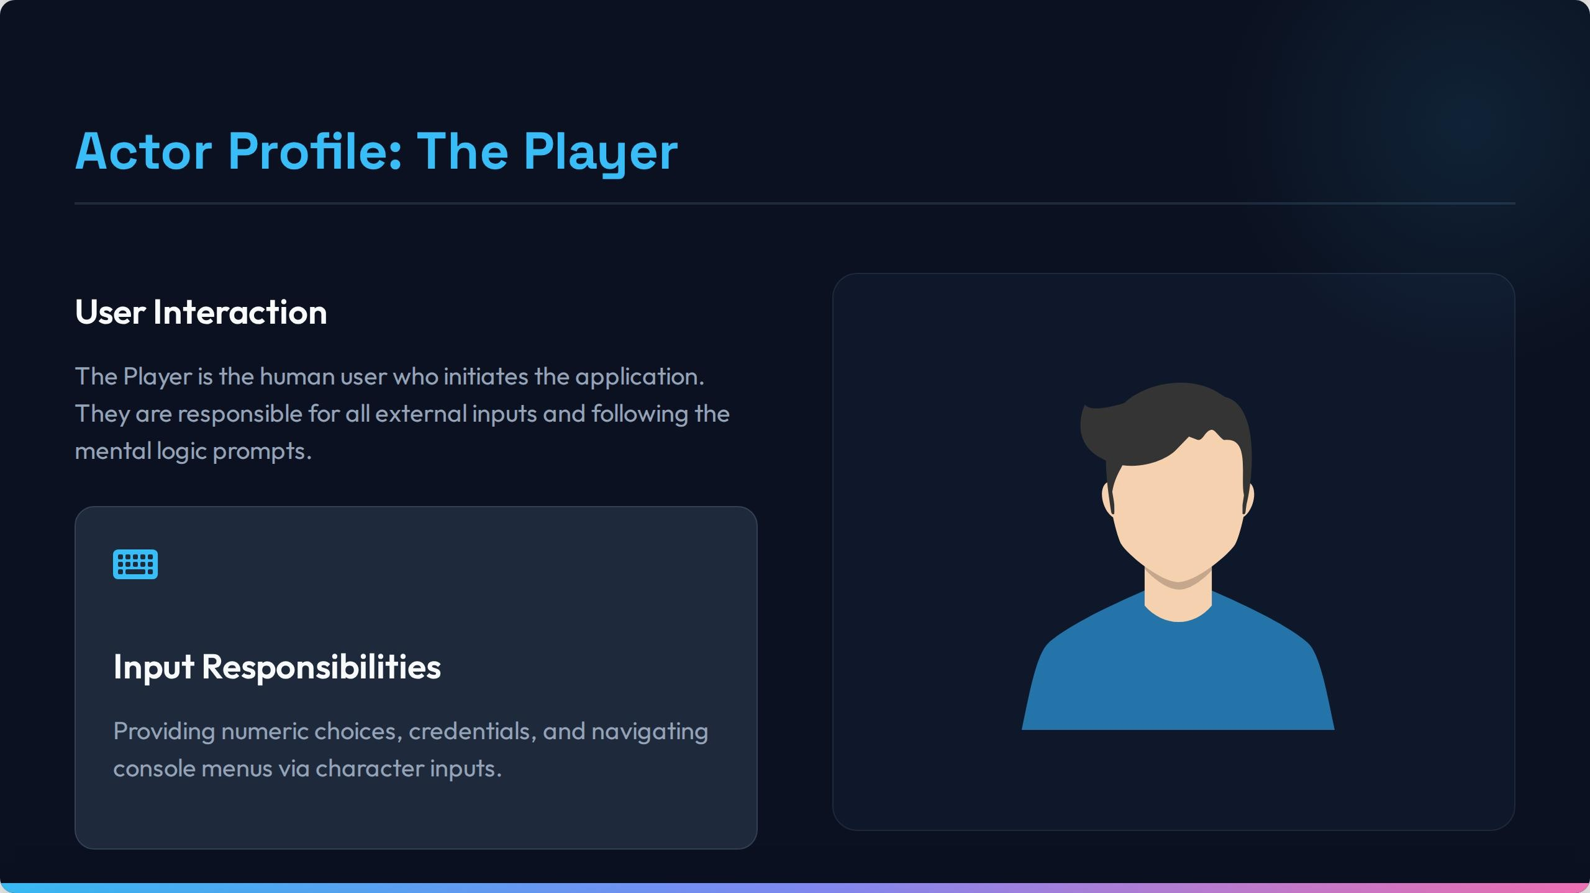

Slide 9
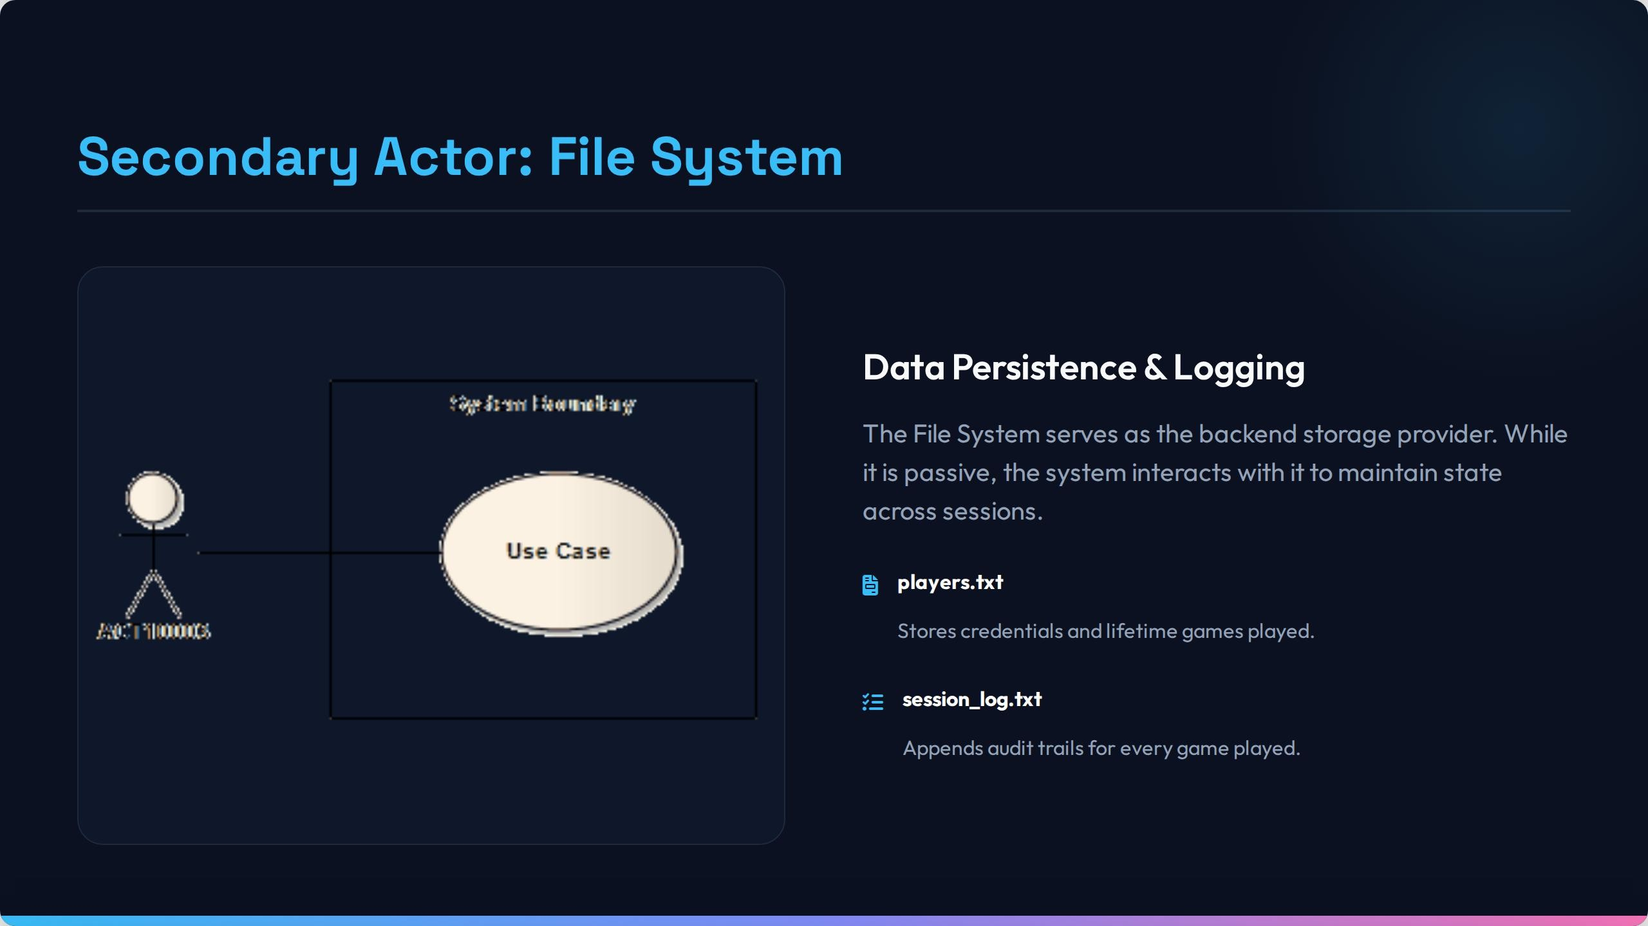

Slide 10
05 / FILE HANDLING
Persistence & Session Logging
players.txt
session_log.txt
File Structure:
Append Mode (ios::app) — Sample Entry:
JohnDoe ← playerName
mypassword123 ← password
7 ← gamesPlayed
Player Name : JohnDoe
Games Played: 7
Magic Number: 5
Session Time: Mon May 18 ...
----------------------------------
Player Name : JohnDoe
Games Played: 8
Magic Number: 3
Session Time: Mon May 18 ...
----------------------------------
WRITE
signUp()
Creates new account
READ
signIn()
Validates credentials
READ
loadPlayerData()
Loads player on start
WRITE
savePlayerData()
Saves after each game

Slide 11






06 / KEY FEATURES
Design Highlights
Polymorphism
Color Console UI
Prize System
Abstract base class Game with pure virtual run(). MindGame overrides it for full implementation.
SetConsoleTextAttribute colors different game states: errors red, success green, prompts cyan.
10 prizes mapped via switch() to possible magic numbers 1–10. Random, rewarding experience.
Input Validation
Scoreboard
Modular Design
menuChoice() loop validates all inputs, handles cin.fail() to prevent bad data crashes.
showScore() displays player name and total games played from persistent file storage.
Each feature (login, gameplay, logging, UI) separated into dedicated private methods.

Slide 12

THANK YOU
Mind Guessing Game Plus
✓ OOP Inheritance
✓ File Persistence
✓ Login Auth
✓ Input Validation
✓ Session Logging
✓ Prize System
C++ Console Application • Object-Oriented Programming

